Slide 1
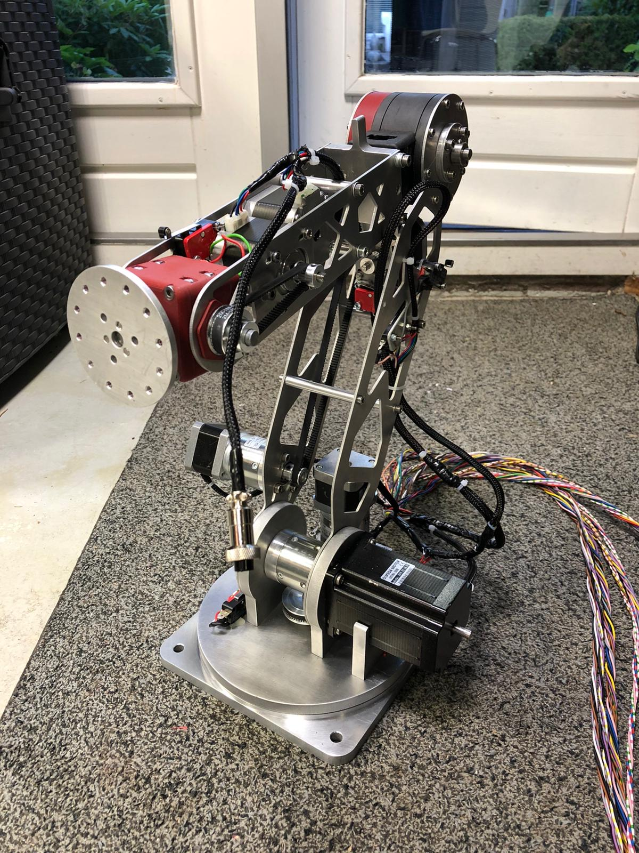
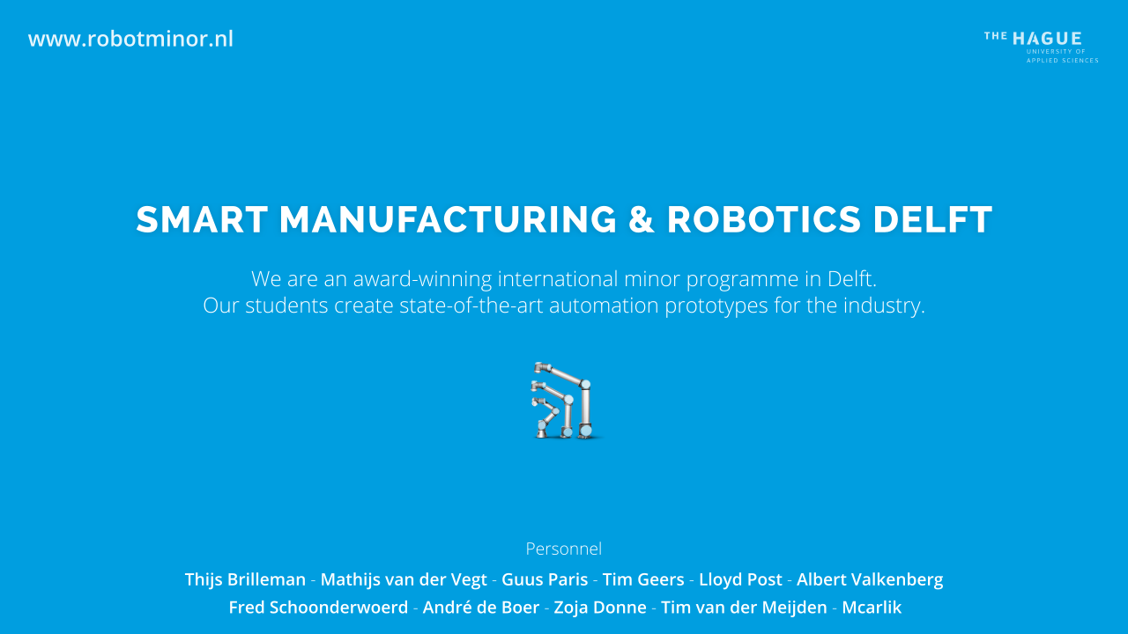
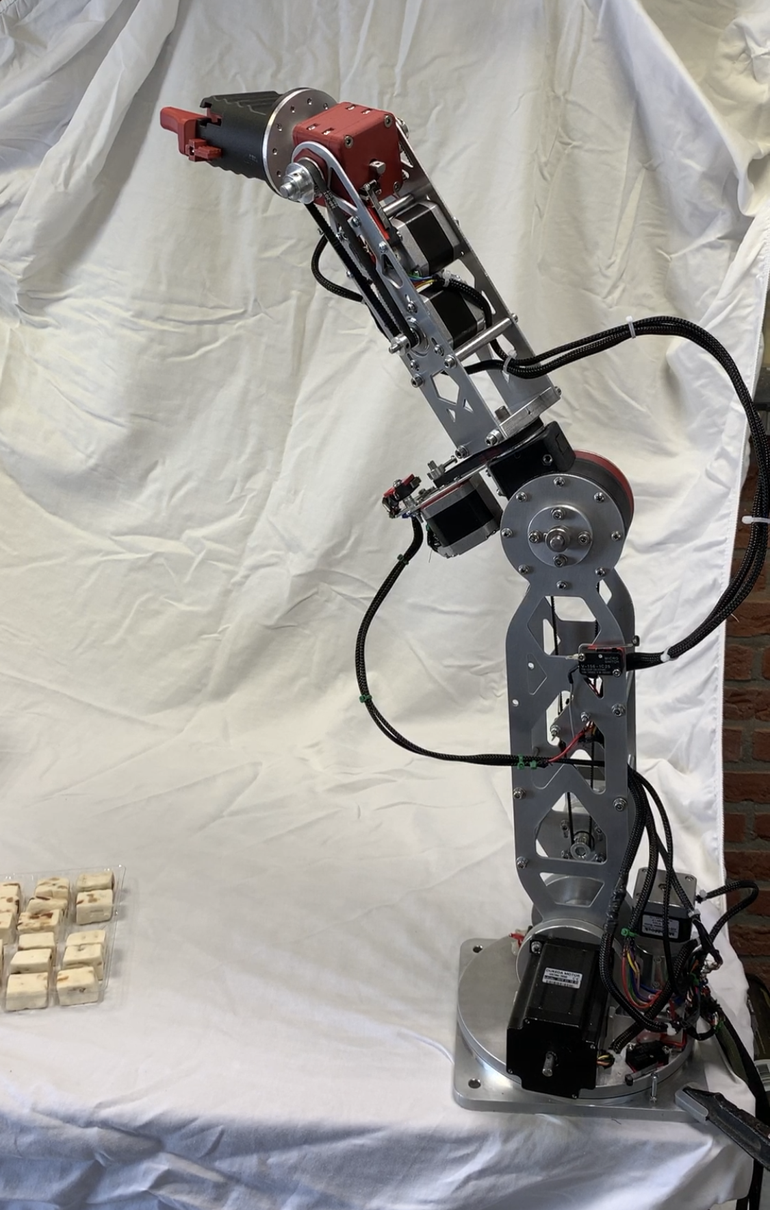
6 - axis robot
Sven den Exter
Stefan Ammerlaan
Thijs de Knegt
25-06-2020
Notes:
Hi everyone!
Thank you all for coming.
My name is Sven den Exter and together with Stefan Ammerlaan and Thijs de Knegt we made this 6 Axis Robot!

Slide 2
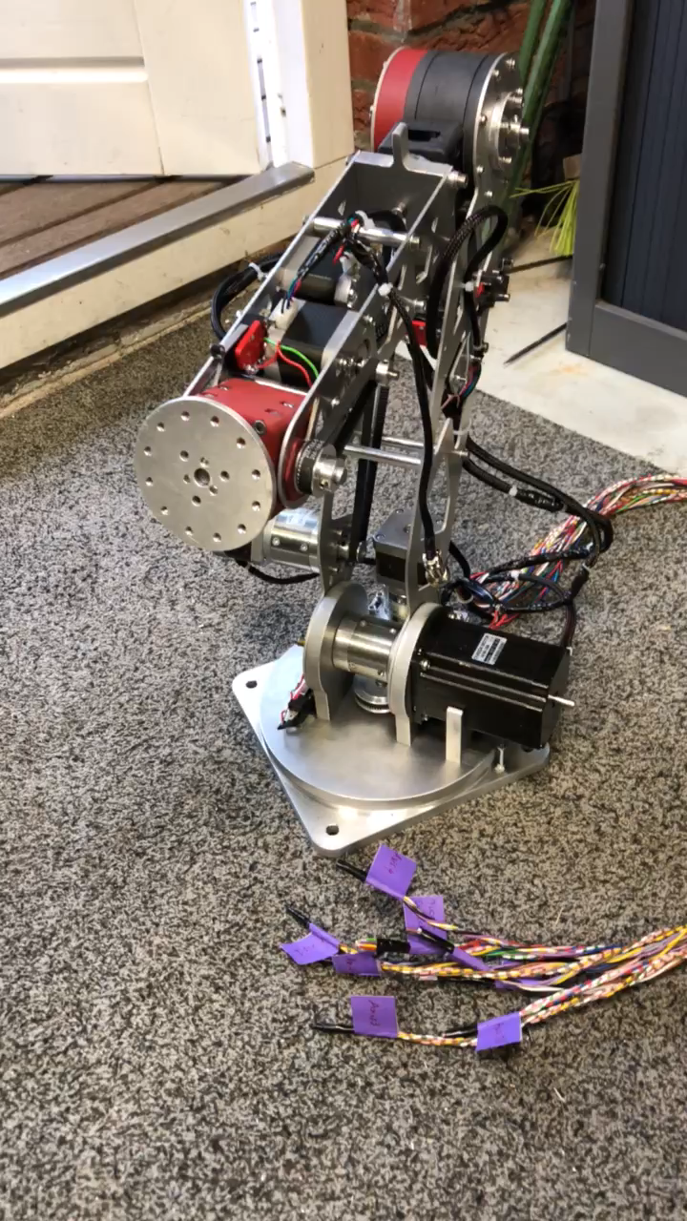
Table of content
Design
Manufacturing
Assembly
Use case
Demo
Notes:
I will tell you some of the processes we went through in short,
Such as:
The designing of the robot
Manufacturing of the robot
The Assembly
Our use case
And finally, we will give a live demonstration of our robot.

Slide 3
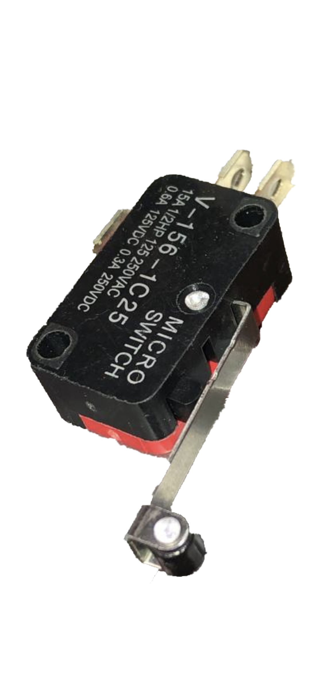
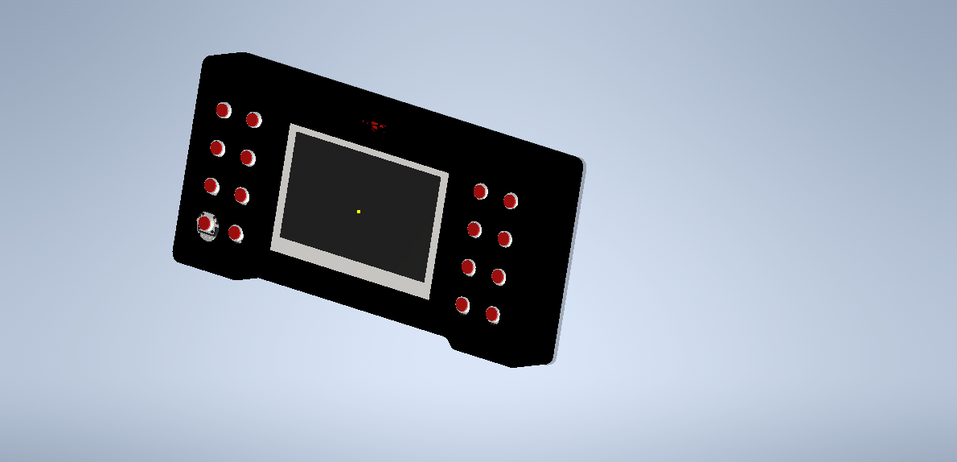
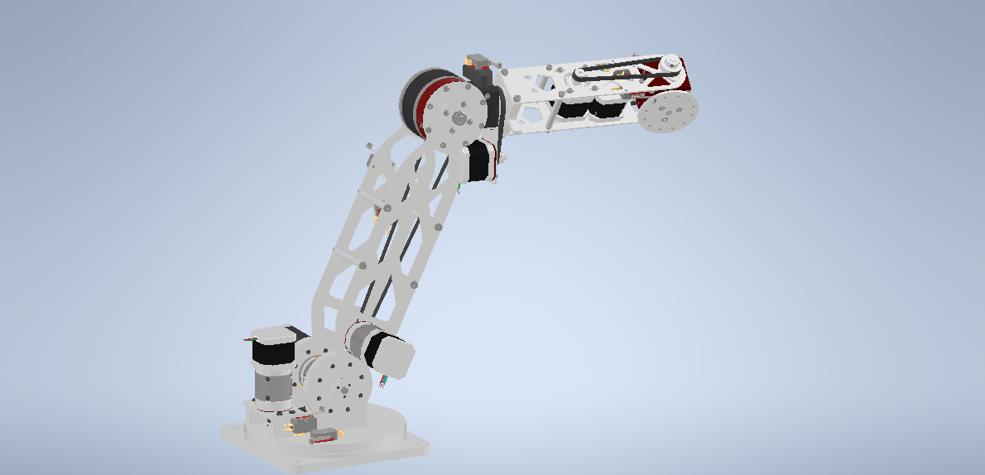
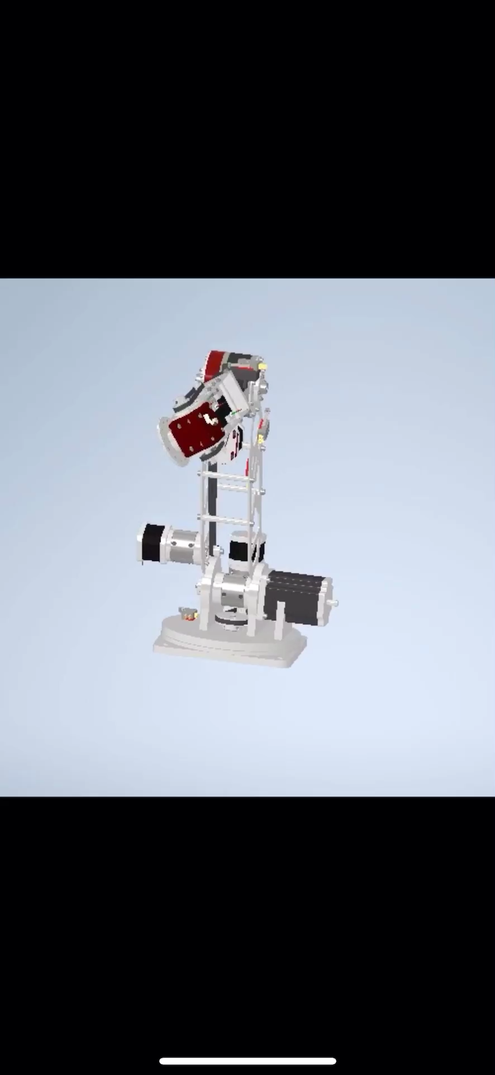
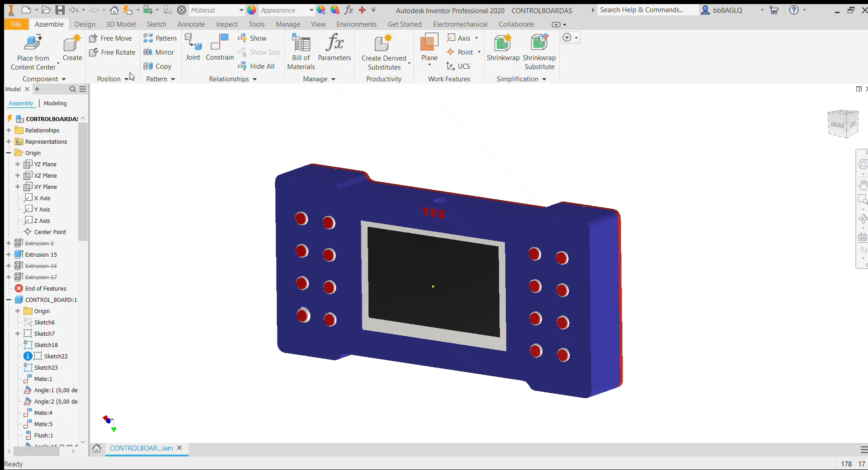
Design
Physics
3D model
Control box & teach pendant
Microswitches
Notes:
We started the design by determining the lenght of the arms followed by calculating the needed torque for the stepper motors.
Then, we designed the robot and the teach pendant in Autodesk Inventor.
To make sure the robot knows it’s position every time it starts up, we use micro switches on each axis to home

Slide 4
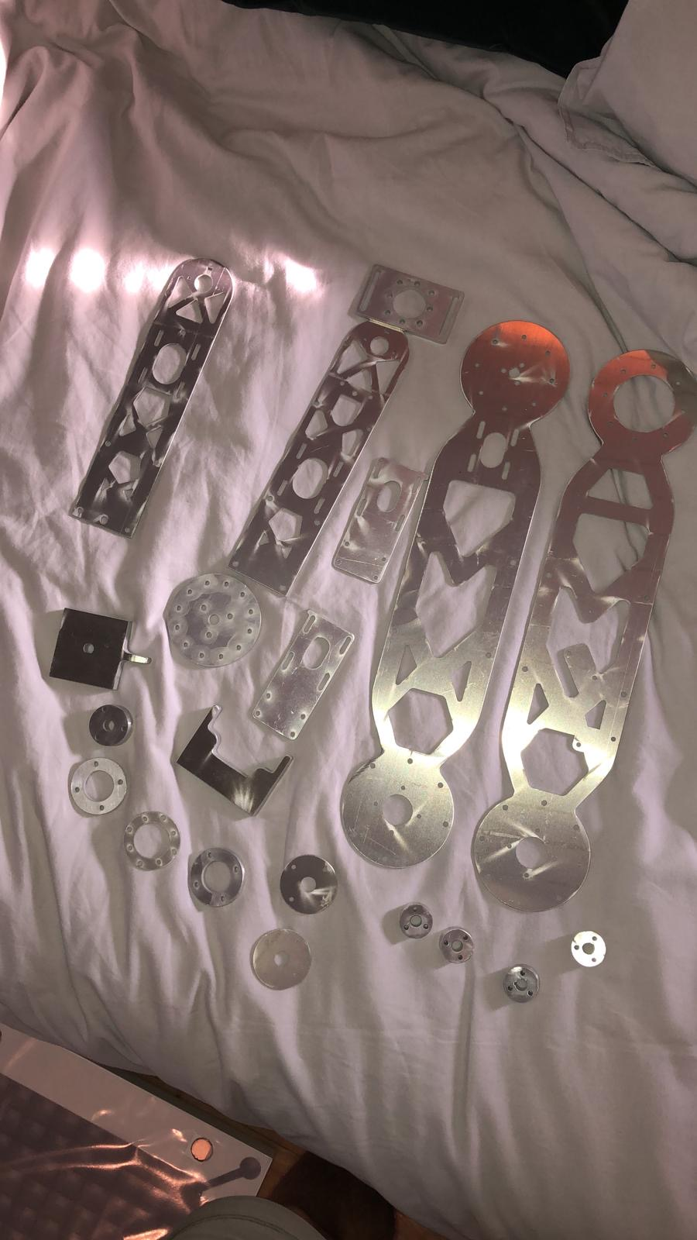
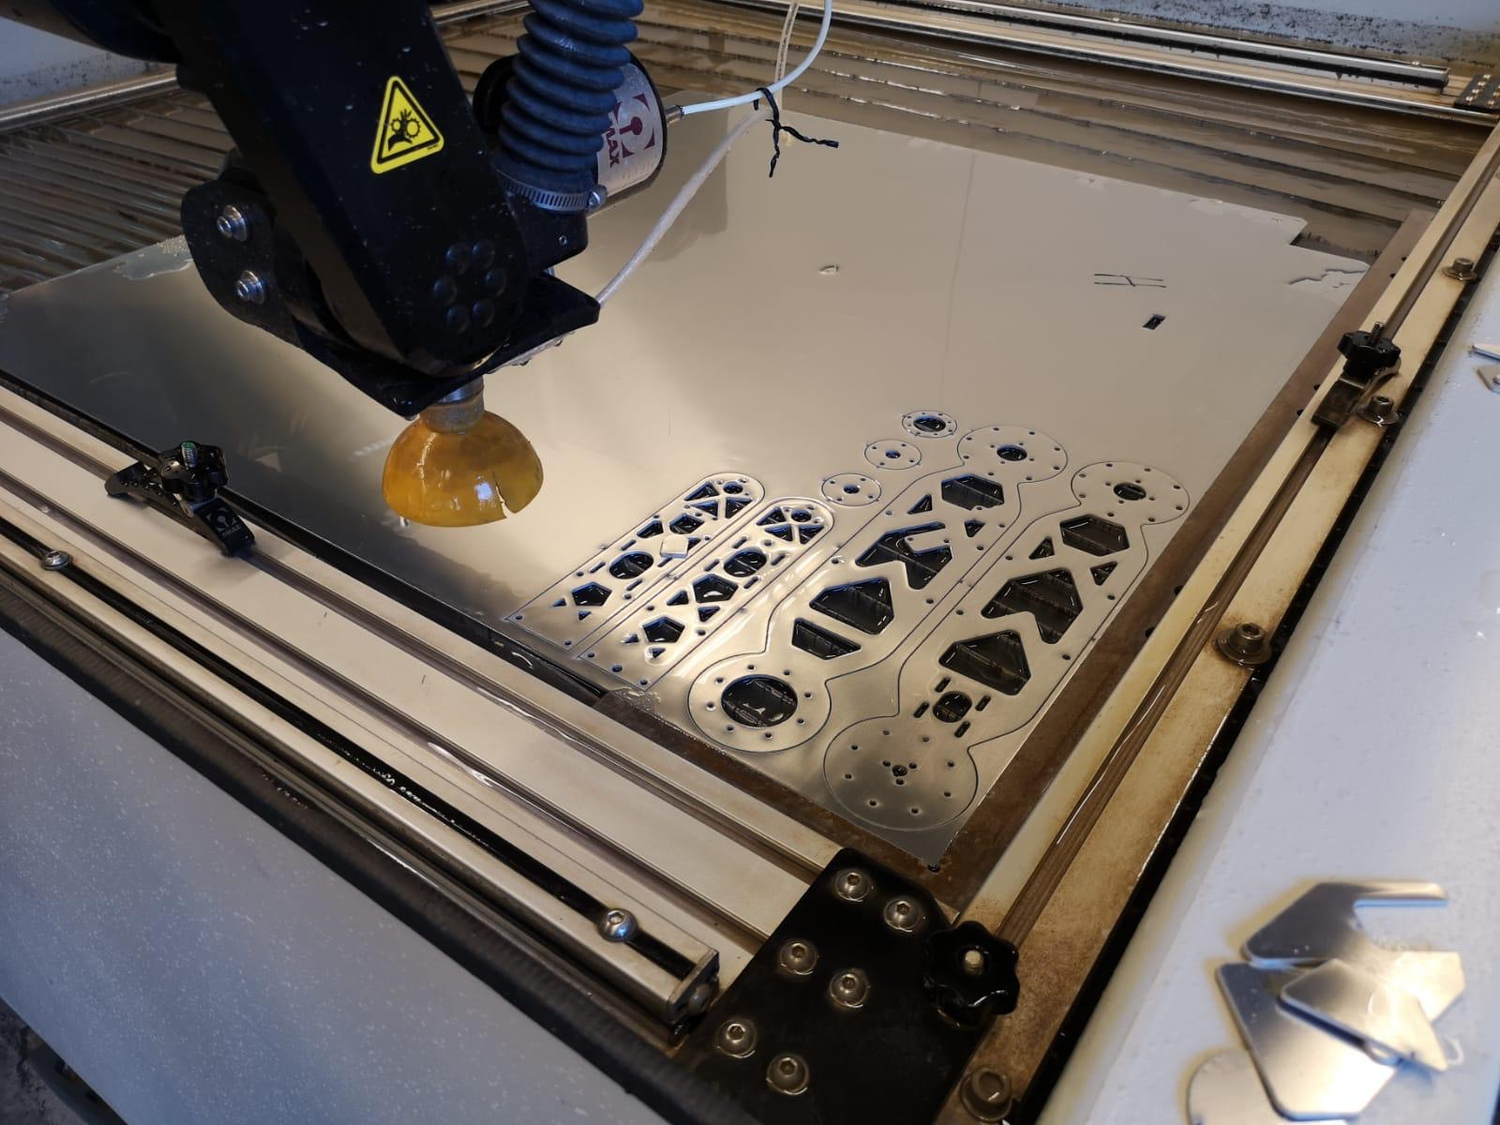
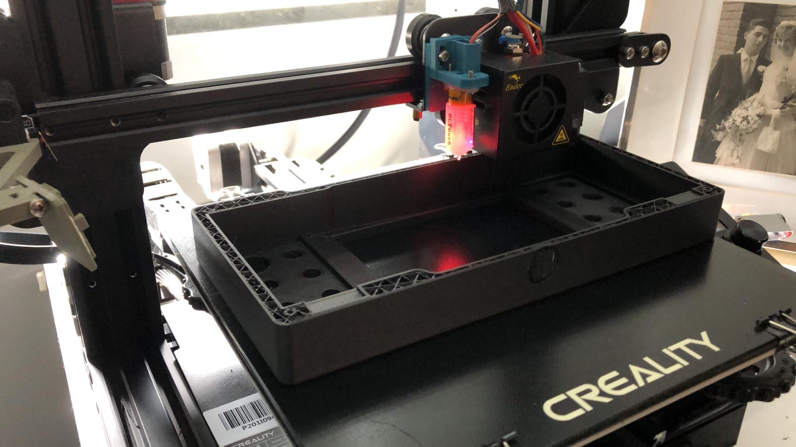
Manufacturing
3D printing
CNC Milling
Waterjet-cutting
Notes:
To manufacture the robot we used several production methods:
We 3D printed some parts of the robot and printed the teach pendant.
We CNC-milled and waterjet-cut the metal parts, providing a rigid structure.

Slide 5
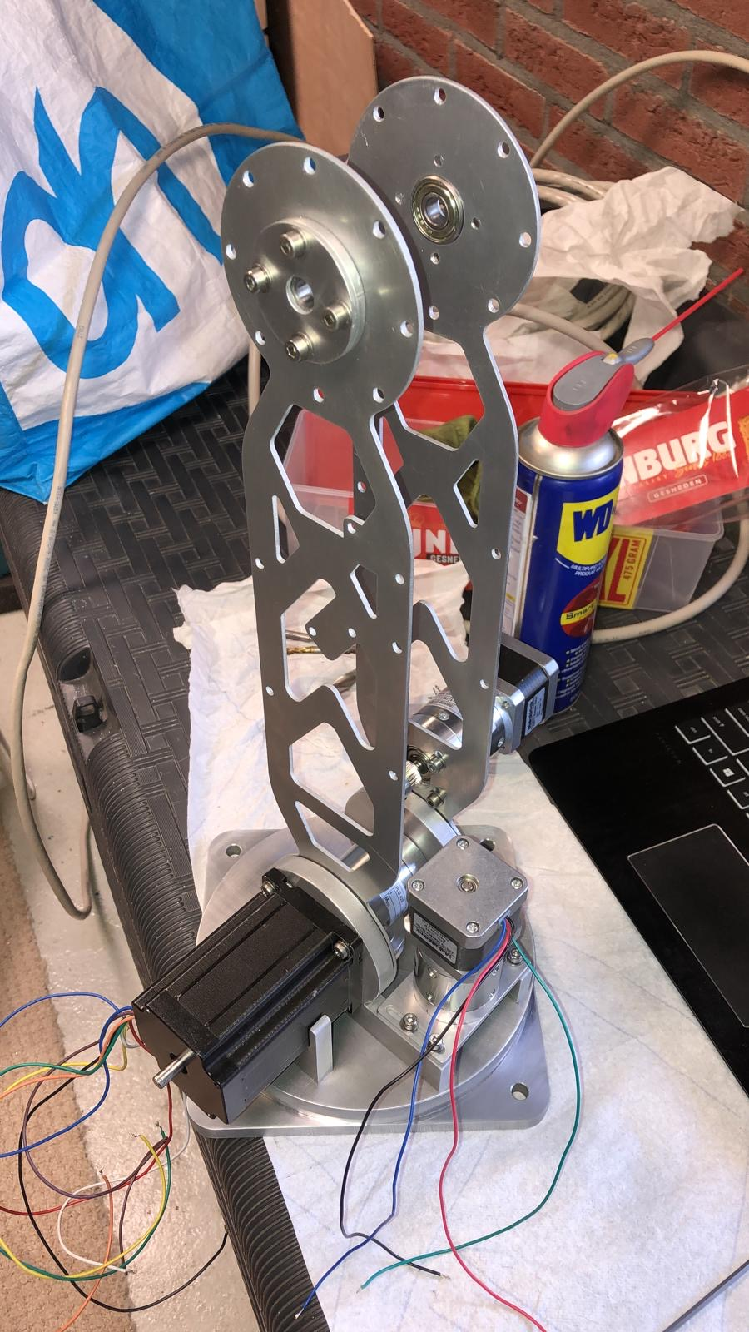
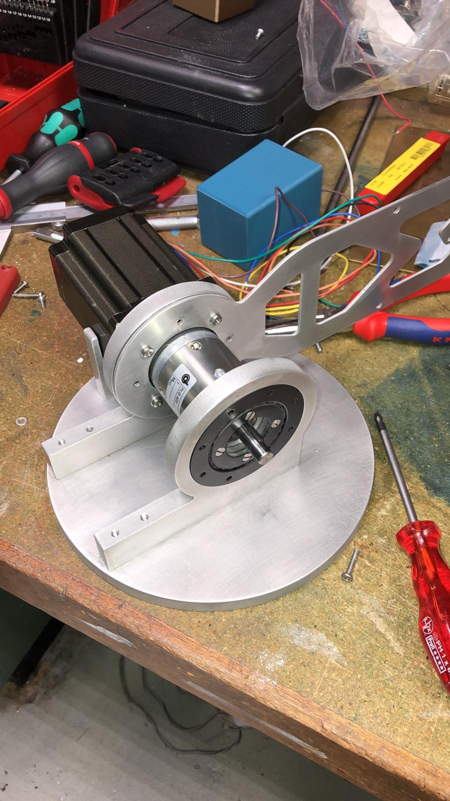
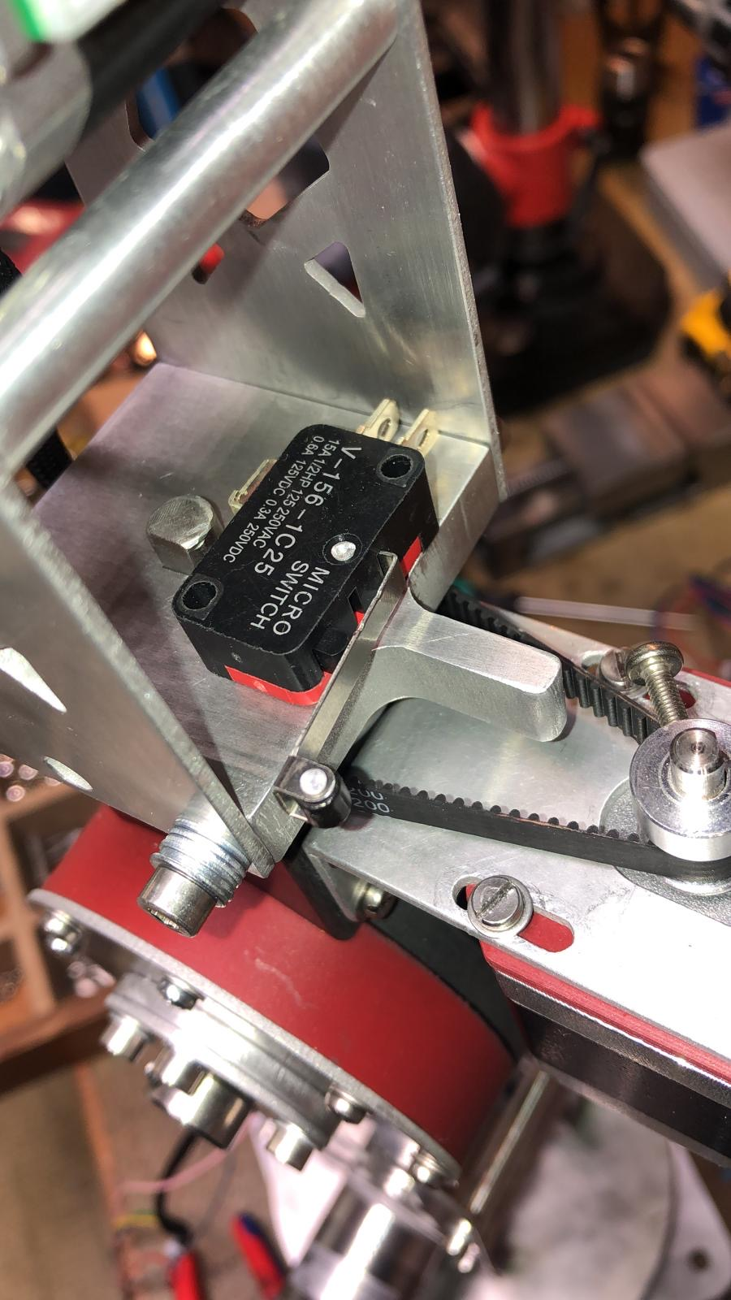
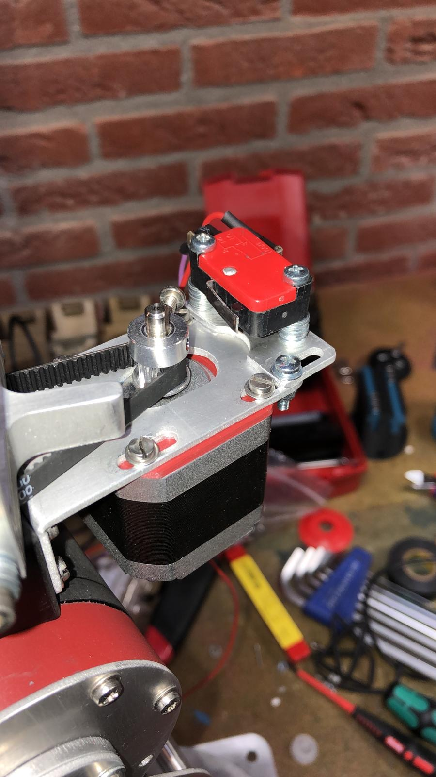
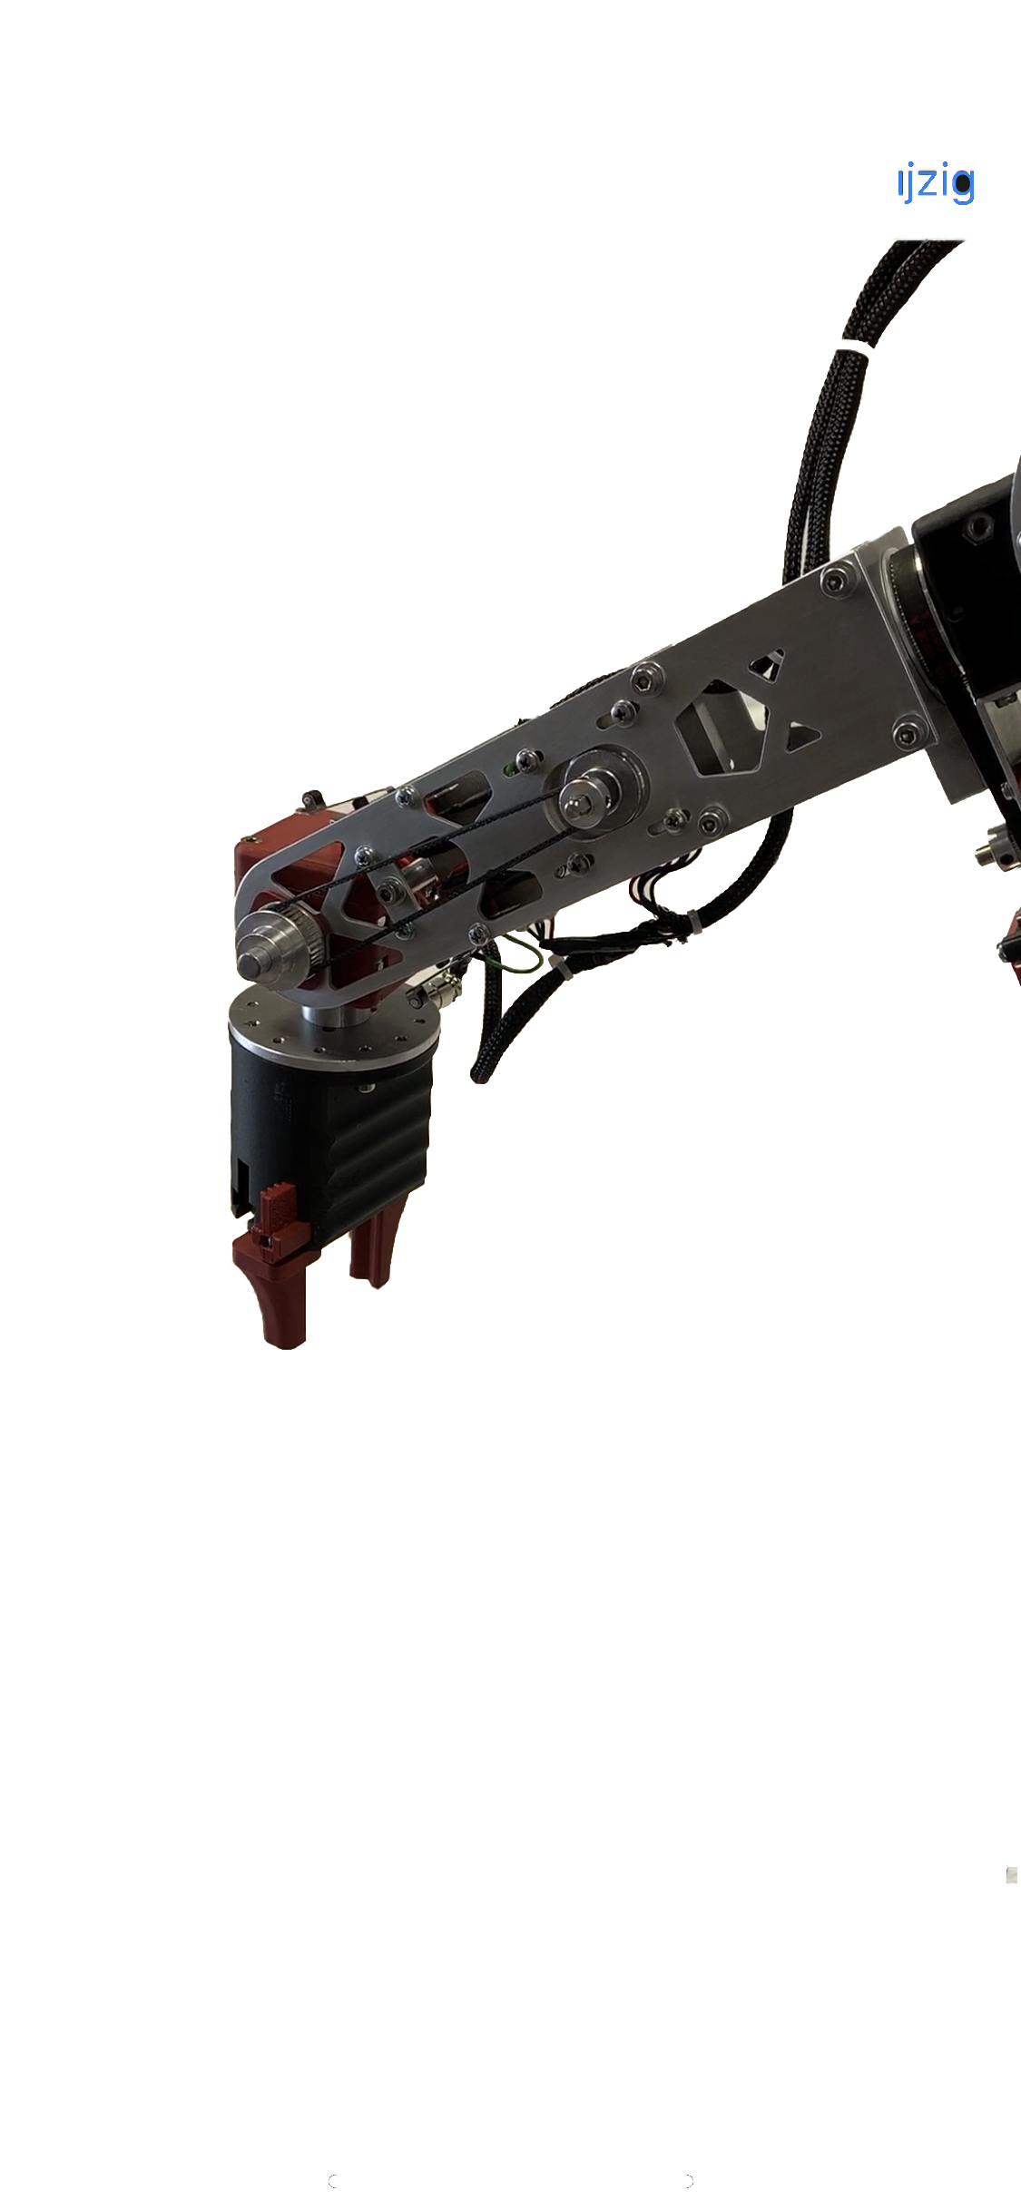
Assembly
Axis
Stepper motors
Microswitches
End effector
Notes:
Here you can see some pictures of the assembly process which includes mounting the motors, microswitches and the and effector.

Slide 6
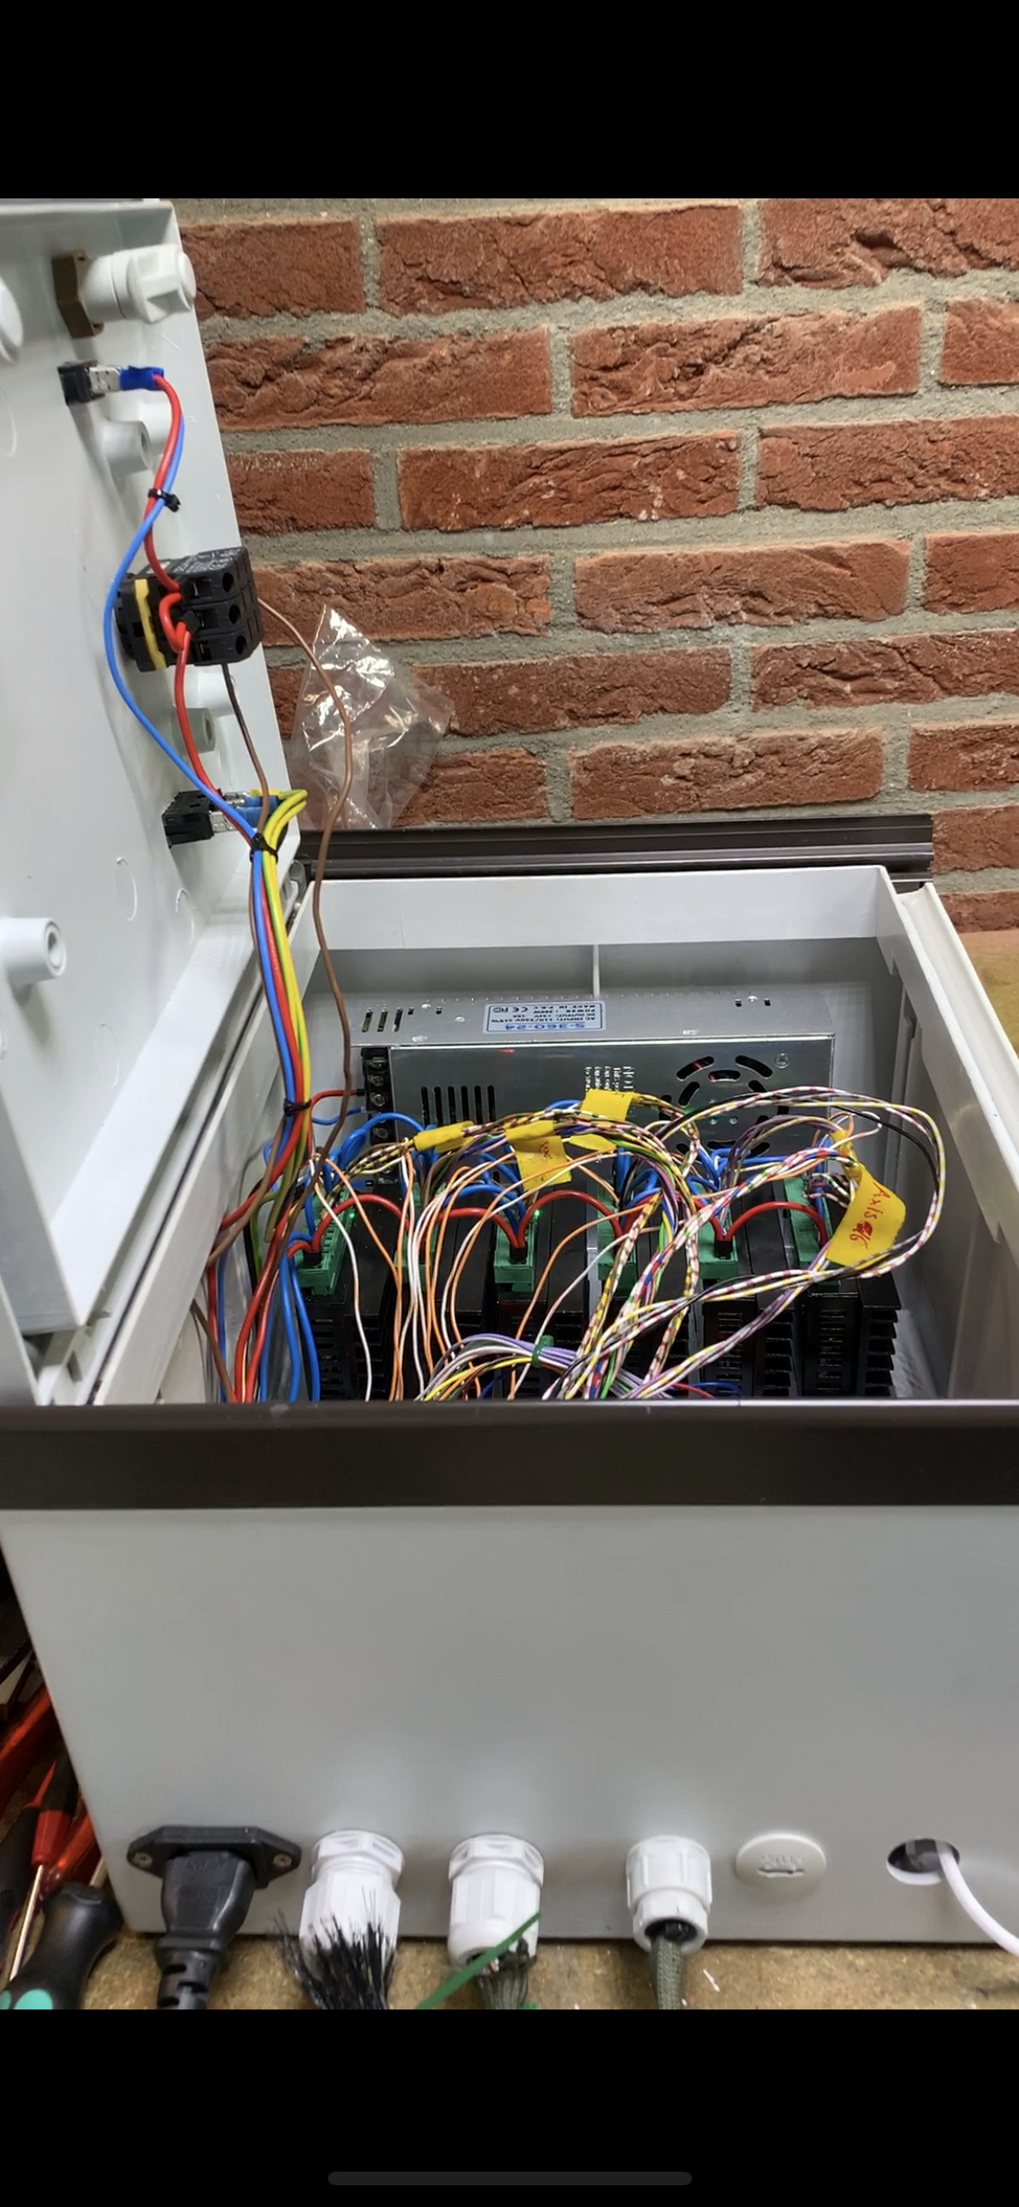
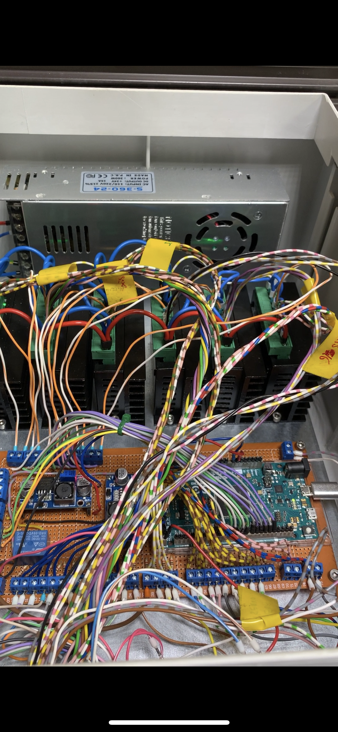
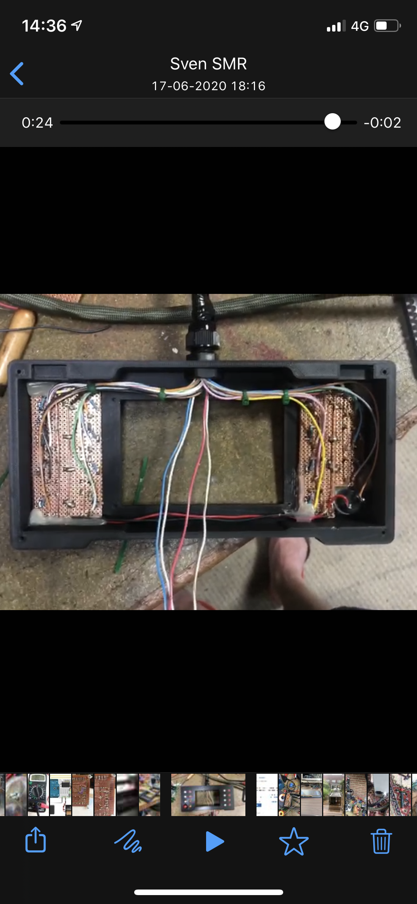
Assembly
Control box
Controller
Notes:
Here you can see our control box and our teach pendant all wired up.

Slide 7
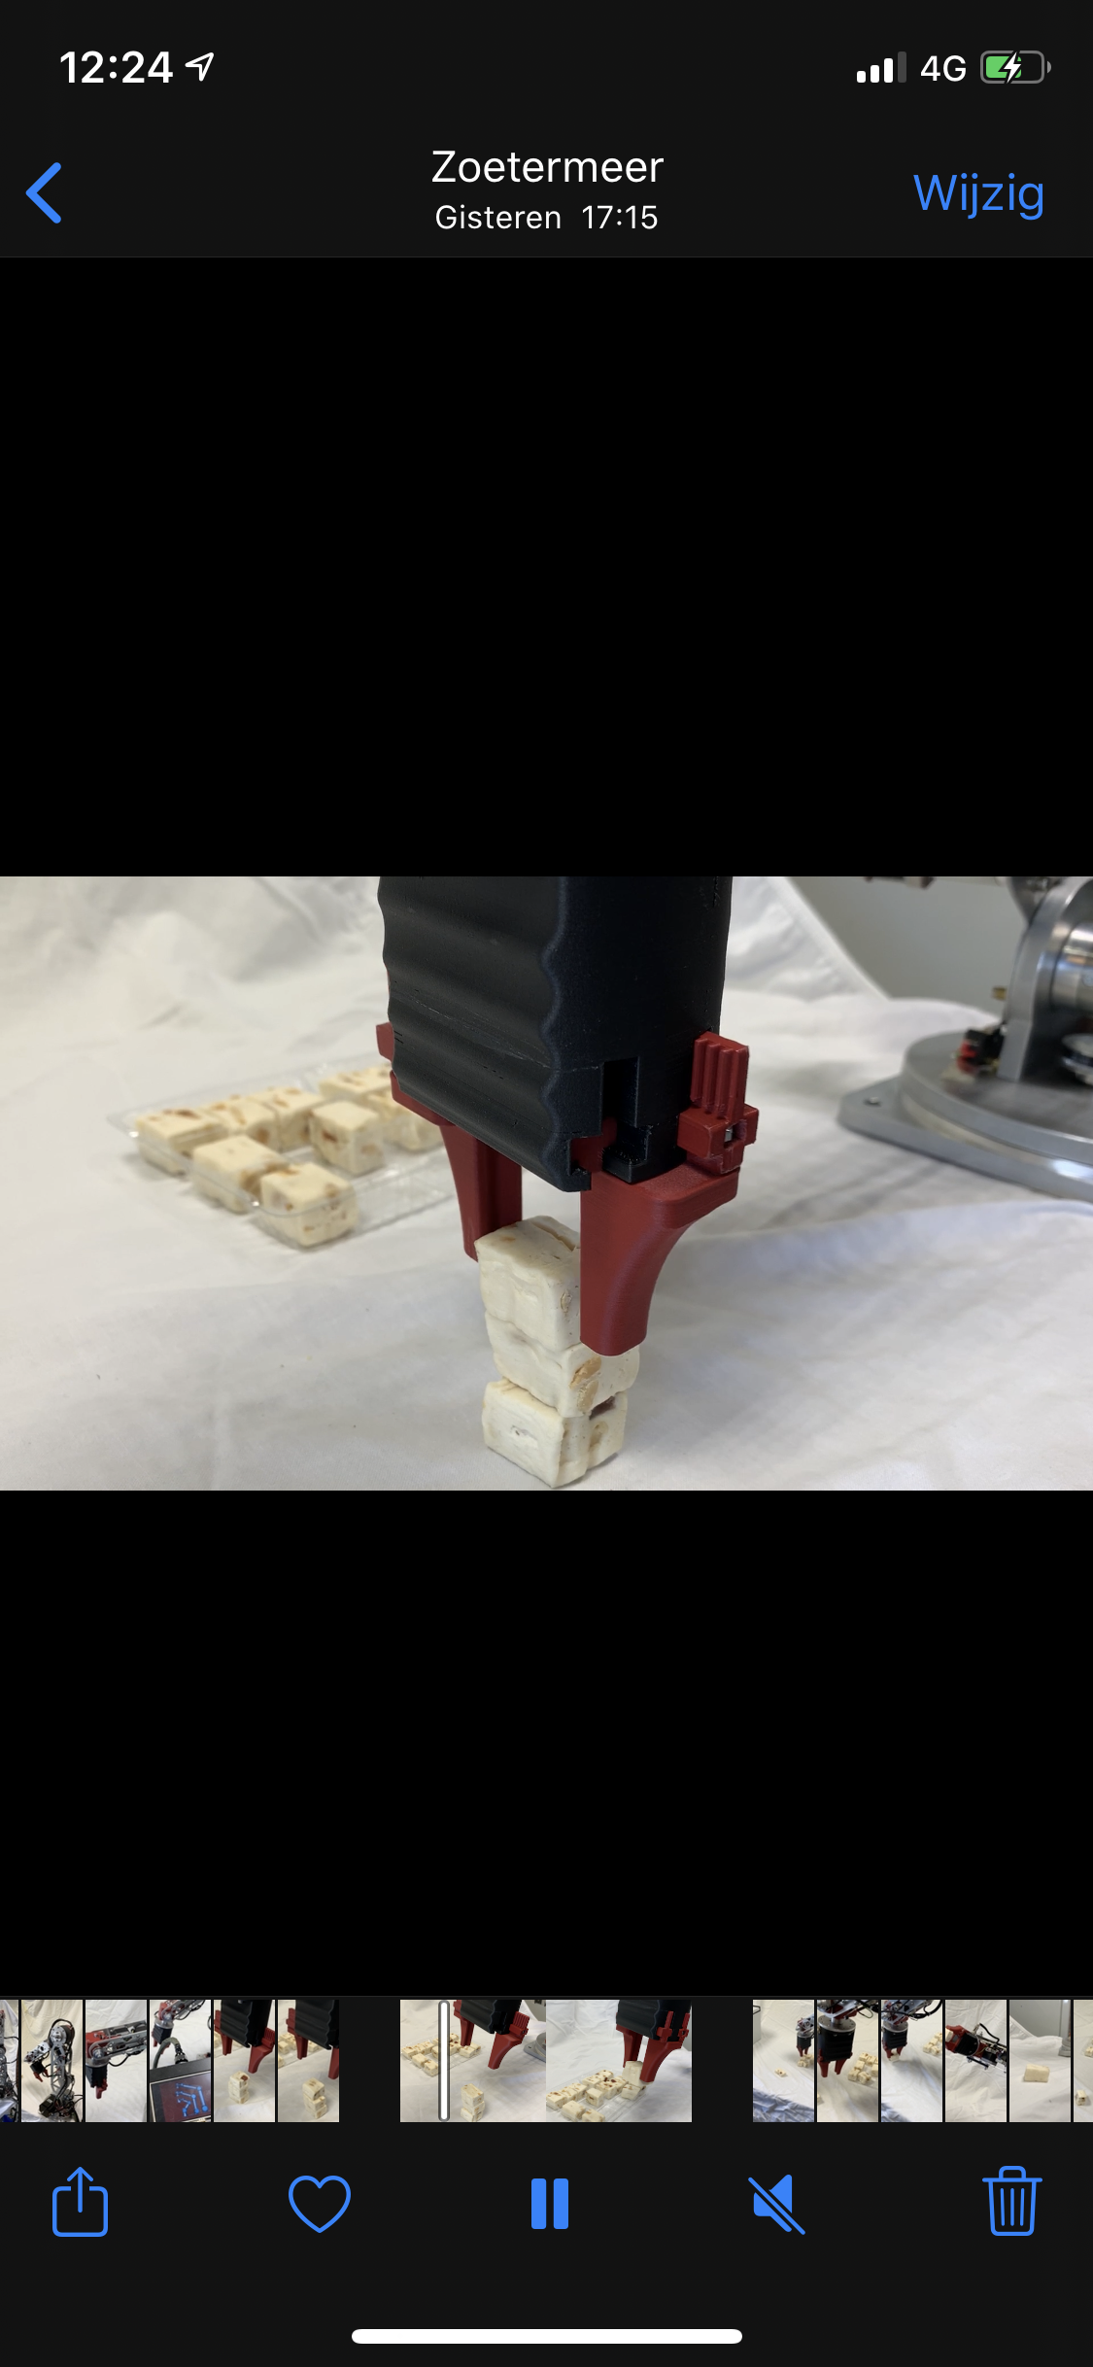
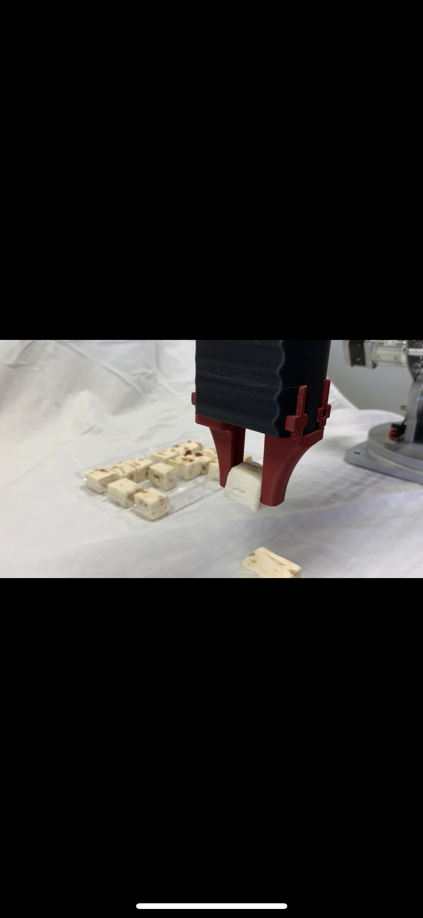
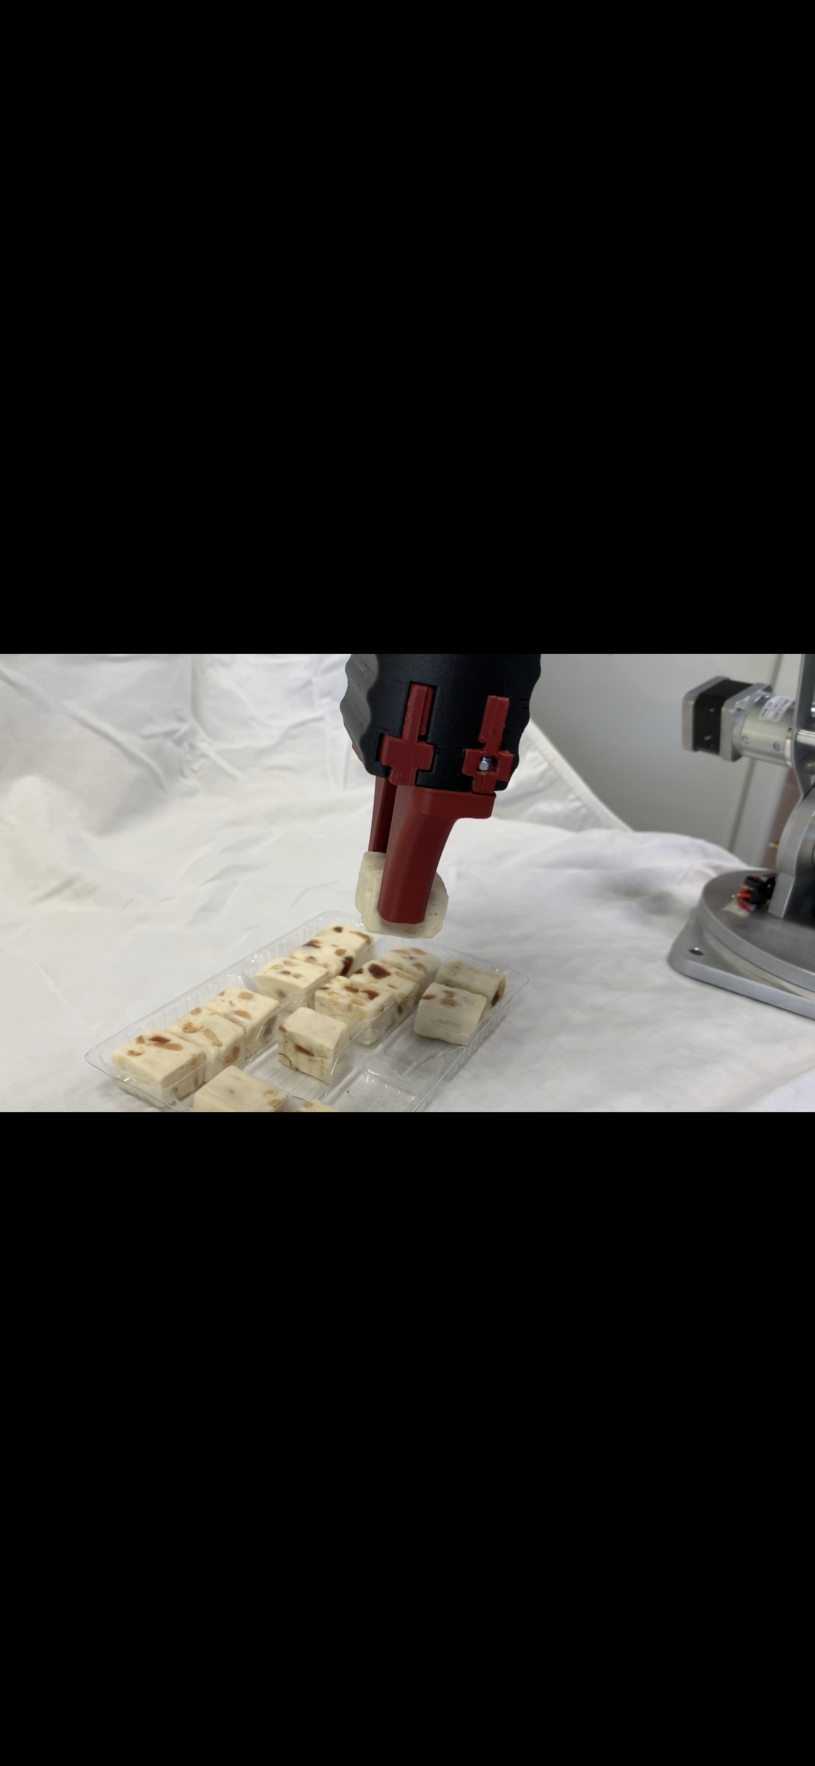
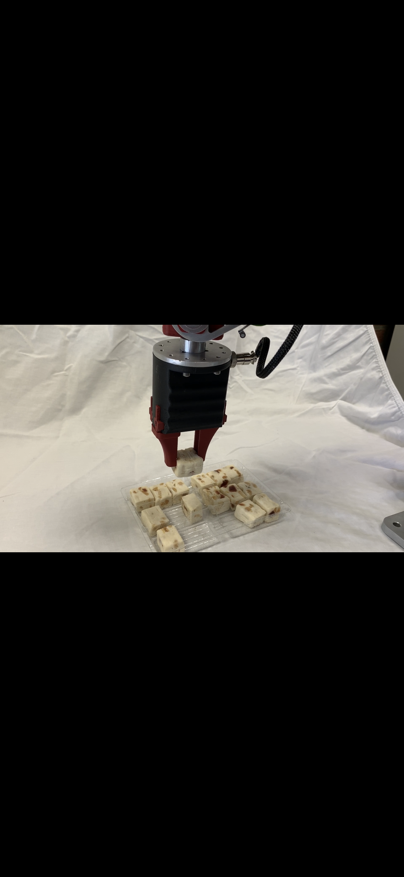
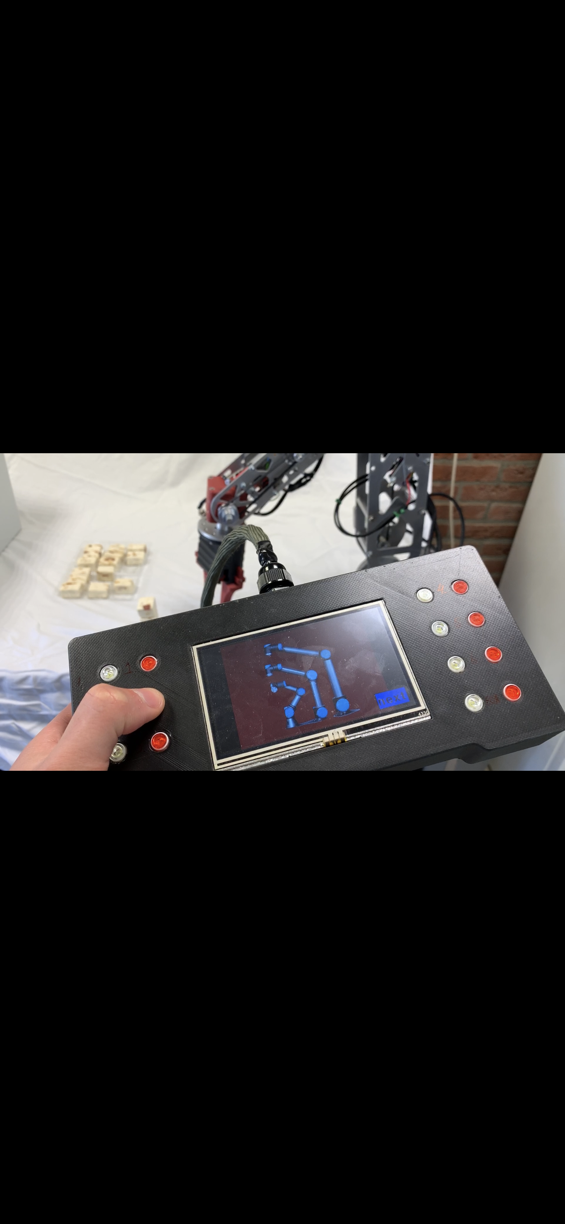

Use case
Pick and place system
Programs & hand control
Notes:
As a use case we decided to pick up blocks of Nougat. But offcourse you could use it for a lot of other use cases. With our modular end-effector you could make it suitable for all kind of products.

Slide 8
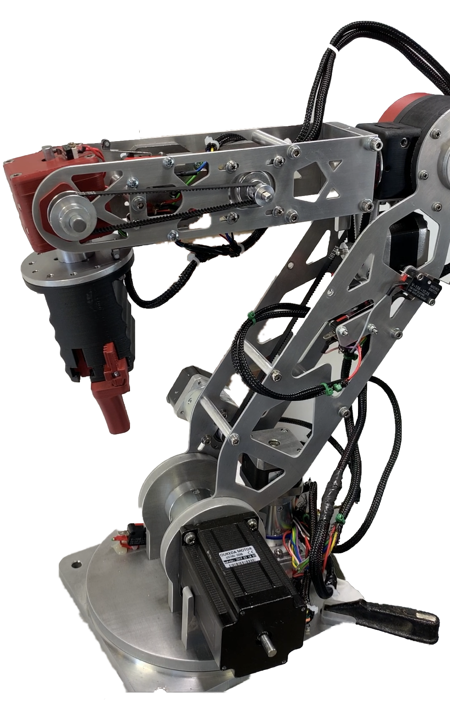



Live demo
Notes:
Now Stefan will give you a demonstration of the robot, while also going into more detail about the working principle of the robot.
After that, your free to ask questions.

